Slide 1
CoVID-19
A Deep Analysis

Slide 2

01.
02.
Series of Events
STATS ABOUT COVID-19
03.
04.
PREVENTION MEASURES
CONCLUSION
Here you could describe the topic of the section
Here you could describe the topic of the section
Here you could describe the topic of the section
Here you could describe the topic of the section

Slide 3
—DR. TEDROS ADHANOM GHEBREYESUS, WORLD HEALTH ORGANIZATION’S DIRECTOR GENERAL
“We cannot say this loudly enough or clearly enough or often enough: All countries can still change the course of this pandemic”

Slide 4
COVID-19
COVID-19 is an infectious disease caused by the recently found virus known as SARS-CoV-2 (or coronavirus). Before the outbreak originated in Wuhan, China on December 2019, there was no information about this virus

Slide 5
Can I get COVID-19?
Yes. COVID-19 is spreading from person to person in parts of the world. Risk of infection from the virus that causes COVID-19 is higher for people who are close contacts of someone known to have COVID-19, for example healthcare workers, or household members. Other people at higher risk for infection are those who live in or have recently been in an area with ongoing spread of COVID-19.

Slide 6
HISTORY
The oldest common ancestor of coronavirus has been dated as far back as the 9th century BC. Some studies published in 1990 specified the most recent common ancestors as follows:
Betacoronavirus: 3300 BC
Deltacoronavirus: 3000 BC
Gammacoronavirus: 2800 BC
Alphacoronavirus: 2400 BC

Slide 7
01.
ABOUT CORONAVIRUS
Series Of Events That led to this Pandemic

Slide 8
SERIES OF EVENTS
31 December 2019
At the close of 2019, the WHO China Country Office was informed of a pneumonia of unknown cause, detected in the city of Wuhan in Hubei province, China. According to the authorities, some patients were operating dealers or vendors in the Huanan Seafood market.
30 January 2020
WHO Director-General Dr Tedros Adhanom Ghebreyesus declared the 2019-nCoV outbreak a Public Health Emergency of International Concern, following a second meeting of the Emergency Committee convened under the International Health Regulations.
11 February 2020
Guidelines mandated that the name of the disease could not refer to a geographical location, an animal, an individual or group of people. It also needed to relate to the disease and be pronounceable. This choice will help guard against the use of other names that might be inaccurate or stigmatizing.
28 February 2020
In a daily COVID-19 press briefing the WHO Director-General said that more than 20 vaccines are in development globally, and several therapeutics are in clinical trials.
20 March 2020
To increase access to reliable information, WHO worked with WhatsApp and Facebook to launch a new WHO Health Alert messaging service.

Slide 9
SYMPTOMS OF COVID-19
HIGH FEVER
TIREDNESS
DRY COUGH
The body temperature can exceed 37.3 Celsius degrees or 99 Fahrenheit degrees
The body feels completely tired and without energy to perform normal tasks
Irritation and constant coughing without expelling any mucus

Slide 10
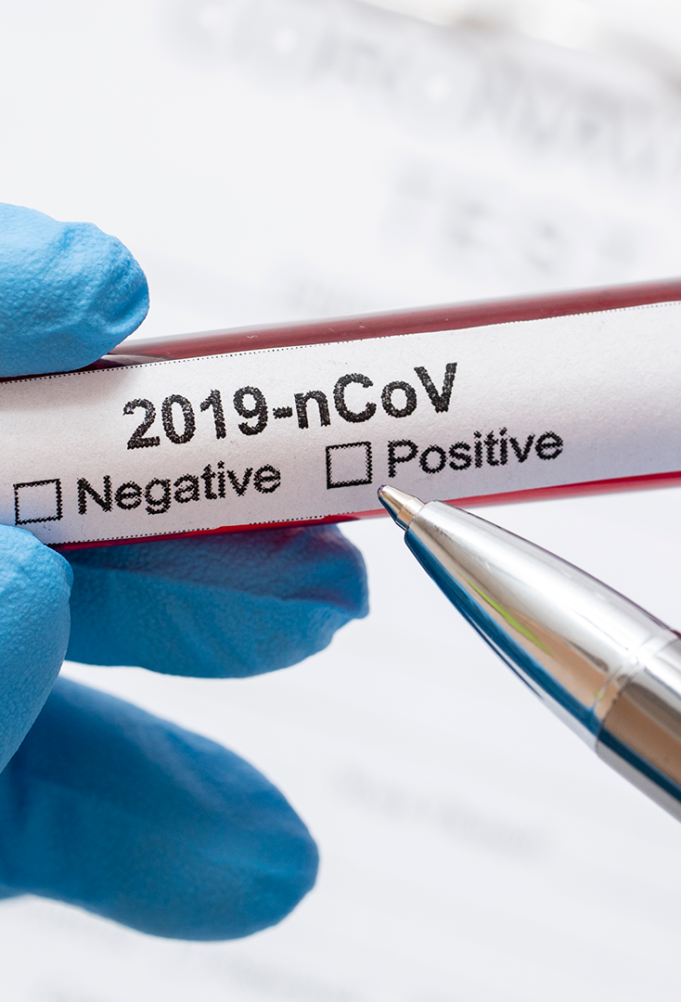
ASYMPTOMATIC PEOPLE
Many people infected with COVID-19 show mild symptoms, especially during the first stages of the disease. Thus, you can still catch the disease from an infected person who only has a mere cough and does not feel ill

Slide 11
INFOGRAPHICS
TIREDNESS
HIGH FEVER
The body feels completely tired, without energy
The body temperature can exceed 37.3 Celsius degrees
DRY COUGH
DIFFICULTY BREATHING
Constant coughing without expelling any mucus
Breathing actually feels more difficult

Slide 12
WHAT TO DO IF YOU HAVE SYMPTOMS
STEP 01
STEP 03
You have symptoms or have been in an infected area
You will be given a home test over the phone
STEP 02
Call the designated phone number for your region

Slide 13
WHAT TO DO IF YOU HAVE SYMPTOMS
STEP 04
Patiently wait for the results of the test
STEP 05
Follow the instructions provided by the doctor

Slide 14
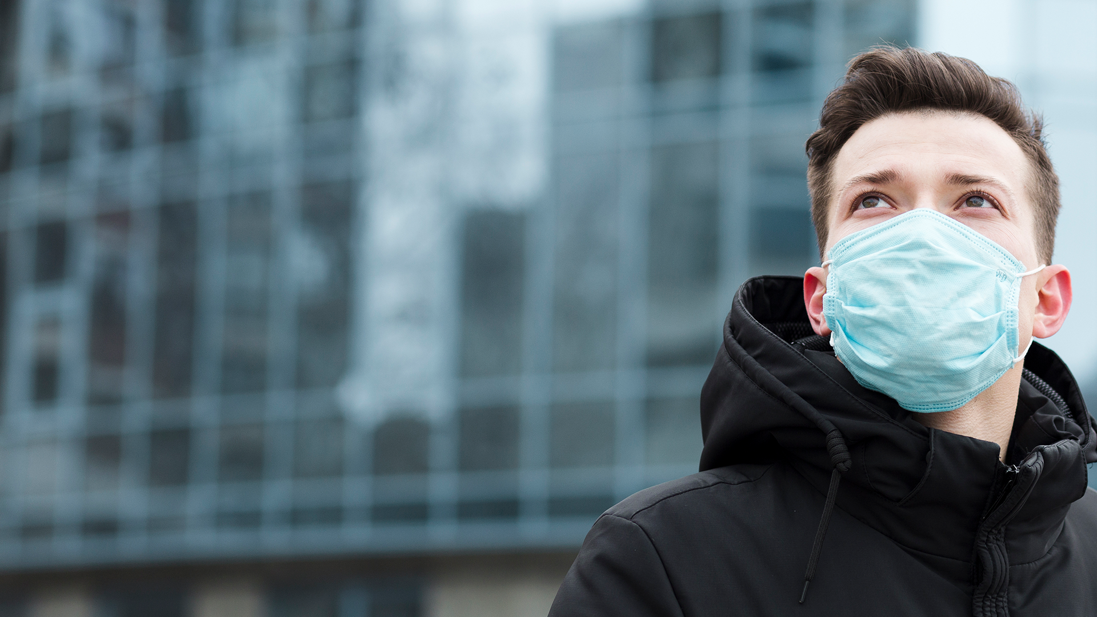
ABOUT 80% OF PEOPLE RECOVER FROM THIS DISEASE WITHOUT NEEDING SPECIAL TREATMENT

Slide 15
02
STATS ABOUT CORONAVIRUS
You could enter a subtitle here if you need it

Slide 16

MORTALITY RATE BY AGE
To modify this graph, click on it, follow the link, change the data and paste the resulting graph here

Slide 17
SOME NUMERICAL DATA
3000+
3.4%
Reported cases in Spain as of March 2020
Global death rate of this novel coronavirus disease

Slide 18
MAP of Covid-19 cases
CDC warns against non-essential travel
Confirmed cases

Slide 19
5 COUNTRIES WITH THE HIGHEST NUMBER OF CASES
 | CONFIRMED | DEATHS
CHINA | 80.000+ | 3,162
ITALY | 12,462 | 827
IRAN | 10,075 | 291
SOUTH KOREA | 7,869 | 12
SPAIN | 3,003 | 84

Slide 20
18,511
118,387
Reported cases of COVID-19 in Europe as of March 2020
Reported cases of COVID-19 globally as of March 2020

Slide 21
12,000+
Reported cases in Italy, the highest number of all European countries

Slide 22
IATA COVID-19 FINANCIAL IMPACT
MARKET | IMPACT ON PASSENGER NUMBERS | IMPACT ON PASSENGER REVENUES
Australia, China, Japan, Malaysia, Singapore, South Korea, Thailand, Vietnam | -23% | -$49.7 billion
Austria, France, Italy, Germany, Netherlands, Norway, Spain, Switzerland, Sweden, the United Kingdom | -24% | -$37.3 billion
Rest of Europe | -9% | -$6.6 billion
Bahrain, Iraq, Iran, Kuwait, Lebanon, the United Arab Emirates | -23% | -$4.9 billion
Rest of Middle East | -9% | -$2.3 billion
Canada and US | -10% | -$21.1 billion

Slide 23
03
PREVENTION MEASURES
You could enter a subtitle here if you need it

Slide 24
ANTIBIOTICS DO NOT WORK AGAINST CORONAVIRUS
04

Slide 25
PROTECTING YOURSELF AND PREVENTING THE SPREAD OF THE DISEASE
Wash your hands with an alcohol-based sanitizer or with soap and water
Keep a distance of at least 1 meter between yourself and anyone who coughs or sneezes
Try your best not to touch your eyes, your nose and your mouth
Cover your mouth and your nose with your bent elbow or a tissue when coughing
Seek medical attention if you have difficulty breathing and a high fever
Follow the directions of your national or local health authorities

Slide 26
PROTECTION MEASURES FOR PEOPLE THAT ARE IN OR VISITED INFECTED AREAS
01
02
Stay home if you do not feel well, even if you feel mild symptoms such as headaches, slight fever and a runny nose
If you need to go out (for example, to buy food or supplies), wear a mask to minimize the risk of infecting others
03
04
If you have difficulty breathing and/or a high fever, seek medical advice as soon as possible
Call your provider and inform them of any recent travel, especially to countries with reported cases

Slide 27
HOW TO USE A MASK
Before wearing a mask, wash your hands with an alcohol-based disinfectant or with soap and water.
Cover your mouth and nose with the mask and make sure the mask is firmly pressed against your face.
Do not touch the mask while you are wearing it; if you do, wash your hands with an alcohol-based disinfectant or with soap and water afterward.
Replace the mask as soon as it gets wet and do not reuse disposable masks.
Remove the mask from behind (do not touch its front side); throw it away in a closed container and then wash your hands with an alcohol-based disinfectant or with soap and water.

Slide 28
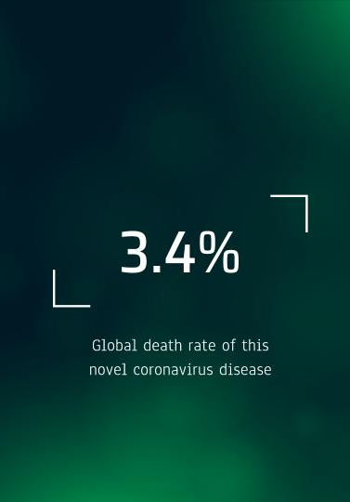
SOCIAL MEDIA
TABLET APP
You can replace the image on the screen with your own work. Just delete this one, add yours and send it to the back

Slide 29

SOCIAL MEDIA
DESKTOP SOFTWARE
You can replace the image on the screen with your own work. Just delete this one, add yours and send it to the back

Slide 30
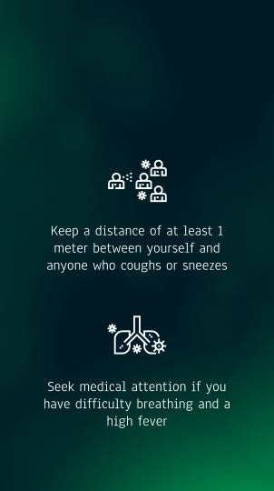
SOCIAL MEDIA
MOBILE WEB
You can replace the image on the screen with your own work. Just delete this one, add yours and send it to the back

Slide 31
THANKS!
Do you have any questions?
@gmail.com
+91

